Slide 1

SummerRay A. Morrow
SummerRayAMorrow@gmail.com
2023
Notes:
Outline*

Slide 2
Executive Summary 3
Introduction 4
Methodology 5
Results 16
Conclusion 45
Outline
Notes:
Outline*

Slide 3
Data Collection:
SpaceX’s Public API, and Web Scraping Wikipedia
Data Wrangling:
Exploratory Data Analysis (EDA) with SQL
Exploratory Data Analysis (EDA) with Data Visualization
Built a Interactive Dash Board with Plotly Dash
Built a Interactive map with Folium
Predictive Analysis via Machine Learning Classification
Summary of all Results:
Exploratory Data Analysis results
Interactive Dash Board for Visual Analytics
Machine Learning Classification Predictive Analysis Results
Executive Summary
Methodologies
Notes:
Executive Summary*

Slide 4
Introduction
SpaceX boasts unusually low launch costs, at just 40% in comparison to competitors.
While a competitors launch can cost upwards of 165 million, SpaceX is able to reuse the first stage of their Falcon 9 rockets bringing launch cost down to just 62 Million.
The goal of this project is use machine learning to predict the viability of Space Y competing with Space X. To determine which factors correlate with Launch success. Such as Orbit Type, Payload Mass, Time, or proximity of Coast Lines, Highways, Railway Lines, and Cities.
Notes:
Introduction*

Slide 5
Section 1 Methodology

Slide 6
Methodology
Executive Summary
Data collection methodology:
Collected data via SpaceX’s REST API, and Web Scraping their Wikipedia page.
Perform data wrangling:
Transformed or removed erroneous data, while appropriately handling missing values.
Perform exploratory data analysis (EDA) using visualization and SQL:
Utilized SQL to filter data to include only those currently relevant, and transformed said data into visual tools such as bar graphs and scatter plots to create summaries of the results.
Perform interactive visual analytics:
Utilized Folium and Ploty Dash to visualize trends in the data.
Perform predictive analysis using classification models:
Utilized classification models, such as Logistic Regression, Support Vector Machine, Decision Tree Classification, and k-Nearest Neighbors, for fine-tuning and data assessment.
Notes:
Means word choice
Data Collection API Lab
jupyter-labs-spacex-data-collection-api.ipynb
Task 1: Request and parse the SpaceX launch data using the GET request
Task 2: Filter the dataframe to only include `Falcon 9` launches
Task 3: Dealing with Missing Values
Data Collection with Web Scraping Lab
jupyter-labs-webscraping.ipynb
Task 1: Request the Falcon9 Launch Wiki page from its URL
Task 2: Extract all column/variable names from the HTML table header
Task 3: Create a data frame by parsing the launch HTML tables
Machine Learning Prediction lab
SpaceX_Machine Learning Prediction_Part_5.ipynb
Task 1: Create a NumPy array from the column "Class" in "data<", by applying the method to_numpy(), then assign it to the variable Y, make sure the output is a Pandas series (only one bracket df\['name of column']).
Task 2: Standardize the data in "X" then reassign it to the variable "X" using the transform provided below.
Task 3: Use the function train_test_split to split the data X and Y into training and test data. Set the parameter test_size to 0.2 and random_state to 2. The training data and test data should be assigned to the following labels. ("X_train, X_test, Y_train, Y_test")
Task 4: Create a logistic regression object then create a GridSearchCV object "logreg_cv" with cv = 10. Fit the object to find the best parameters from the dictionary "parameters".
Task 5: Calculate the accuracy on the test data using the method "score":
Task 6: Create a support vector machine object then create a "GridSearchCV" object "svm_cv" with cv - 10. Fit the object to find the best parameters from the dictionary "parameters".
Task 7: Calculate the accuracy on the test data using the method "score":
Task 8: Create a decision tree classifier object then create a "GridSearchCV" object "tree_cv" with cv = 10. Fit the object to find the best parameters from the dictionary "parameters".
Task 9: Calculate the accuracy of tree_cv on the test data using the method "score"
Task 10: Create a k nearest neighbors object then create a "GridSearchCV" object "knn_cv" with cv = 10. Fit the object to find the best parameters from the dictionary "parameters".
Task 11: Calculate the accuracy of tree_cv on the test data using the method "score":
Task 12: Find the method performs best

Slide 7
Data collected:
Flight Number
Launch Site
Payload Mass (kg)
Orbit
Launch outcome
Booster Version
Date
Time
Data Collection
SpaceX REST API Call and Web Scraping Wikipedia
Notes:
Data Collection API Lab
jupyter-labs-spacex-data-collection-api.ipynb
TODO: Web Scrapping
Flight No., Date and time (UTC), Version booster, Payload, Payload mass, Orbit, Customer, Launch Outcome, Booster landing
Data Collection Via SpaceX’s REST API
SpaceX REST API Call -> API Returns Json -> Create Dataframe from Json -> Wrangle Data -> Export Data
Web Scraping Wikipedia
Get HTML response from Wikipedia -> Extract data using BeautifulSoup -> Create Dataframe from Data -> Wrangle Data -> Export Data

Slide 8
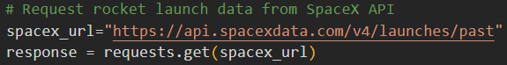
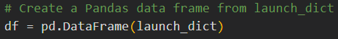
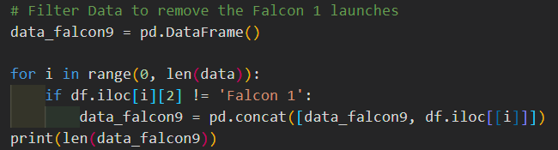
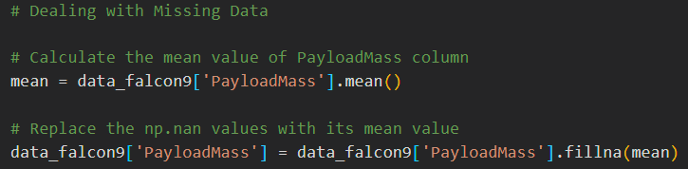
Data Collection
SpaceX API Call
Retrieve SpaceX’s launch data via calling a GET request to their Rest API.
Convert return to a JSON object.
Add said object to a Pandas dataframe.
Filter data to include only Falcon 9 launches, effectively removing all other booster models.
Address missing values by calculating the mean of the remaining data, and replacing ‘np.nan’ values.
Note: Not all code blocks are included here, the rest can be found by checking the following link. https://github.com/SummerRayMorrow
Notes:
Data Collection API Lab
jupyter-labs-spacex-data-collection-api.ipynb
Instructions: Present your data collection with SpaceX REST calls using key phrases
My Answer: The first step was to retrieve SpaceX’s launch data via calling a GET request to their Rest API, which returns a JSON object. Said object was added to a Pandas dataframe. Next the data were filtered to include only `Falcon 9` launches, effectively removing all other booster* models.
Finally, missing values were addressed by calculating the mean of the remaining data, to replace ‘np.nan’ values.
Present your data collection with SpaceX REST calls using key phrases and flowcharts
Add the GitHub URL of the completed SpaceX API calls notebook (must include completed code cell and outcome cell), as an external reference and peer-review purpose
Place your flowchart of SpaceX API calls here
Data Collection Via SpaceX’s REST API
SpaceX REST API Call -> API Returns Json -> Create Dataframe from Json -> Export Data

Slide 9
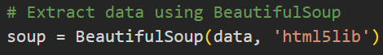
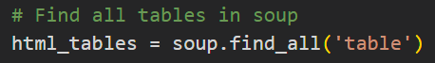
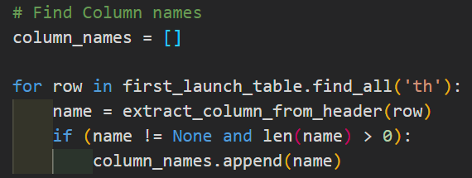
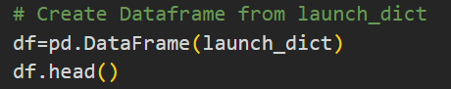
Data Collection
Web Scraping Wikipedia
Request the Falcon 9 Launch information from the Wiki page.
Extract all data tables using BeautifulSoup.
Get variable names from the HTML table’s header.
Create pandas data frame from the collected data.
Note: Not all code blocks are included here, the rest can be found by checking the following link. https://github.com/SummerRayMorrow
Notes:
Data Collection with Web Scraping Lab
jupyter-labs-webscraping.ipynb
Request the Falcon 9 Launch information from the Wiki page.
Extract all data tables using BeautifulSoup.
Get variable names from the HTML table’s header.
Create pandas data frame from the collected data.
Web Scraping Wikipedia
Get HTML response from Wikipedia -> Extract data using BeautifulSoup -> Create Dataframe from Data -> Export Data

Slide 10
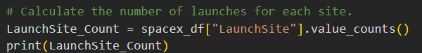
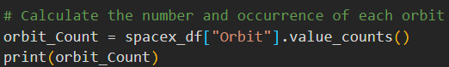
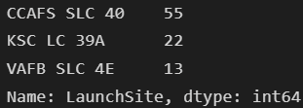
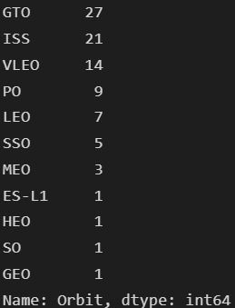
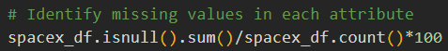
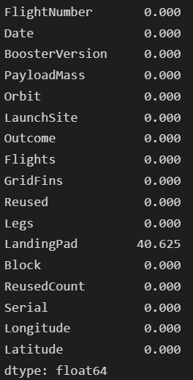
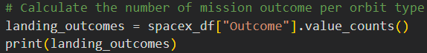
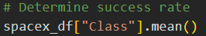
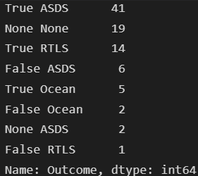
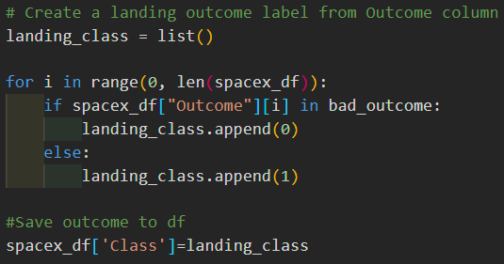
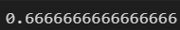
Data Wrangling One Hot Encoding
Calculate from launches from each site.
Calculate occurrences within each orbit.
Calculate mission outcomes per orbit type.
Create a landing outcome label.
Handle missing values.
Determine Success Rate
Note: Not all code blocks are included here, the rest can be found by checking the following link. https://github.com/SummerRayMorrow
Notes:
Data Wrangling Lab
labs-jupyter-spacex-Data wrangling.ipynb
Using One Hot Encoding:
Calculate the number of launches on each site.
Calculate the number of occurrences within each orbit.
Calculate the number of occurrences of mission outcomes per orbit type.
Create a landing outcome label from the Outcome column.
Handle missing values by replacing them with the mean.

Slide 11




Bar Graphs
Show relationship between numeric and categorical variables.
Success rate vs. Orbit
Line graphs
Show trends of global behavior.
Success rate vs. Year
Exploratory Data Analysis Data Visualization
Scatter Plot Jittered Strip
Show correlation between variables.
Flight Number vs. Payload Mass
Flight Number vs. Launch Site
Payload vs. Launch Site
Orbit vs. Flight Number
Payload vs. Orbit Type
Orbit vs. Payload Mass
Pie Charts Show ratios.
Successful vs. Failed Launches
https://github.com/SummerRayMorrow
Notes:
EDA with Visualization
jupyter-labs-eda-dataviz.ipynb
Scatter Graphs: Scatter plots show relationship between variables. This relationship is called the correlation.
• Flight Number vs. Payload Mass
• Flight Number vs. Launch Site
• Payload vs. Launch Site
• Orbit vs. Flight Number
• Payload vs. Orbit Type
• Orbit vs. Payload Mass
Bar Graph: Bar graphs show the relationship between numeric and categoric variables.
• Success rate vs. Orbit
Line Graph: Line graphs show data variables and their trends. Line graphs can help to show global behavior and make prediction for unseen data.
• Success rate vs. Year
Task 1: Visualize the relationship between Flight Number and Launch Site
Task 2: Visualize the relationship between Payload and Launch Site
Task 3: Visualize the relationship between success rate of each orbit type
Task 4: Visualize the relationship between Flight Number and Orbit type
Task 5: Visualize the relationship between Payload and Orbit type
Task 6: Visualize the launch success yearly trend

Slide 12
Exploratory Data Analysis SQL
Task 1: Display the names of the unique launch sites in the space mission
Task 2: Display 5 records where launch sites begin with the string 'KSC’
Task 3: Display the total payload mass carried by boosters launched by NASA (CRS)
Task 4: Display average payload mass carried by booster version F9 v1.1
Task 5: List the date where the first successful landing outcome in a drone ship was achieved.
Task 6: List the names of the boosters which have success in ground pad and have payload mass greater than 4000 but less than 6000
Task 7: List the total number of successful and failure mission outcomes
Task 8: List the names of the booster_versions which have carried the maximum payload mass. Use a subquery
Task 9: List the records which will display the month names, successful landing_outcomes in ground pad ,booster versions, launch_site for the months in year 2017
Task 10: Rank the count of successful landing_outcomes between the date 2010-06-04 and 2017-03-20 in descending order.
https://github.com/SummerRayMorrow
Notes:
EDA with SQL
jupyter-labs-eda-sql-edx.ipynb
Exploratory Data Analysis
EDA with SQL Lite
jupyter-labs-eda-sql-edx_sqllite.ipynb
Task 1: Display the names of the unique launch sites in the space mission
Task 2: Display 5 records where launch sites begin with the string 'KSC'
Task 3: Display the total payload mass carried by boosters launched by NASA (CRS)
Task 4: Display average payload mass carried by booster version F9 v1.1
Task 5: List the date where the first successful landing outcome in a drone ship was achieved.
Task 6: List the names of the boosters which have success in ground pad and have payload mass greater than 4000 but less than 6000
Task 7: List the total number of successful and failure mission outcomes
Task 8: List the names of the booster_versions which have carried the maximum payload mass. Use a subquery
Task 9: List the records which will display the month names, successful landing_outcomes in ground pad ,booster versions, launch_site for the months in year 2017
Task 10: Rank the count of successful landing_outcomes between the date 2010-06-04 and 2017-03-20 in descending order.

Slide 13


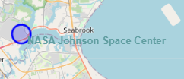
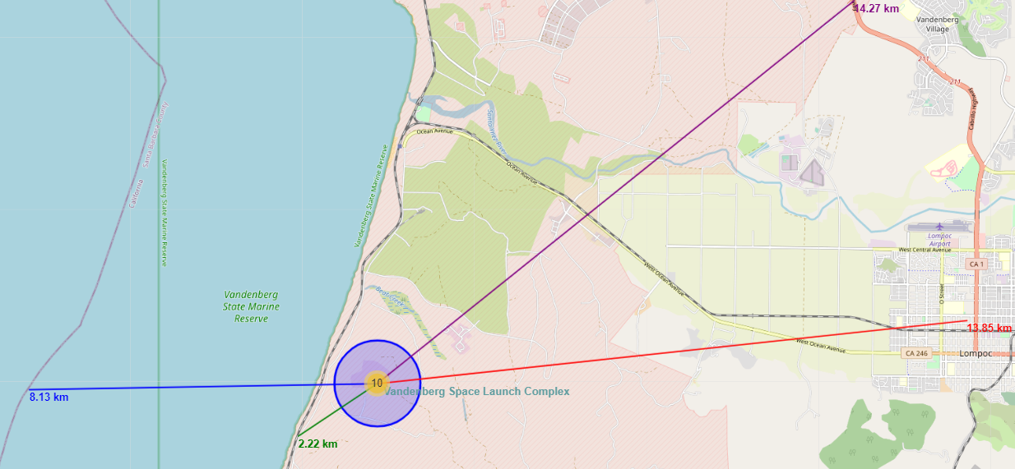
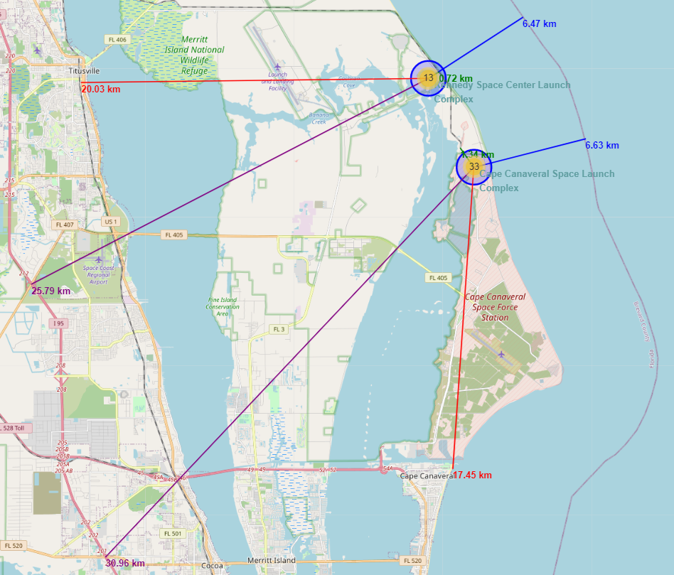
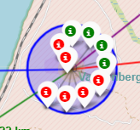
Added Markers, Marker Clusters, circles, and Lines to a Folium map.
The color of each marker indicated the success vs. failure status of the said launch.
The Marker Clusters show individual child markers gathered into groups for analysis.
Circles showed where the launch sites, and Nasa’s Johnson space center are located.
Lines show the distance between each launch site and the nearest coastline, city, railway, and highway.
Build an Interactive Map
Folium
https://github.com/SummerRayMorrow
Notes:
Interactive Visual Analytics with Folium
lab_jupyter_launch_site_location.ipynb
Task 1: Mark all launch sites on a map.
Task 2: Mark the success and failed launches for each site on the map.
Task 3: Calculate the distances between a launch site to its proximities.

Slide 14
Build a Dashboard
Plotly Dash
Built an interactive dashboard using Plotly Dash, with a drop-down menu to select visualization methods. Including a pie chart that shows the success vs. failure rates of launches from each site and a Scatter plot, specifically a Jittered Strip Plot, showing the correlation between the class of boaster (v1.1, FT, B4, and B5) vs. the payload mass with a Range slider meant to select a payload range, in intervals of 1k kgs, from 0k to 10k.
https://github.com/SummerRayMorrow
Notes:
Build an Interactive Dashboard with Ploty Dash
spacex_dash_app.py
Task 1: Add a dropdown list to enable Launch Site selection.
Task 2: Add a pie chart to show the total successful launches count for all sites.
Task 3: Add a callback function for `site-dropdown` as input, `success-pie-chart` as output.
Task 4: Add a callback function for `site-dropdown` and `payload-slider` as inputs, `success-payload-scatter-chart` as output.

Slide 15
Predictive Analysis Classification
Prepared Data
Built Models
Evaluated Models
Compared Models
Used the data collected in earlier labs, NumPy arrays, and Padas data frames to transform and normalize the data. By splitting the data into two separate sets for training and testing.
Built four machine learning models: Logistic Regression, Support Vector Machine, Decision Tree, and K-Nearest Neighbors.
Using grid search to find each model's best tuned hyperparameters and accuracy score. Comparing each model's Confusion Matrix to find the most accurate model.
As it turned out, all four performed about the same and were not statistically distinct.
https://github.com/SummerRayMorrow
Notes:
Machine Learning Prediction lab
SpaceX_Machine Learning Prediction_Part_5.ipynb
Task 1: Create a NumPy array from the column "Class" in "data<", by applying the method to_numpy(), then assign it to the variable Y, make sure the output is a Pandas series (only one bracket df\['name of column']).
Task 2: Standardize the data in "X" then reassign it to the variable "X" using the transform provided below.
Task 3: Use the function train_test_split to split the data X and Y into training and test data. Set the parameter test_size to 0.2 and random_state to 2. The training data and test data should be assigned to the following labels. ("X_train, X_test, Y_train, Y_test")
Task 4: Create a logistic regression object then create a GridSearchCV object "logreg_cv" with cv = 10. Fit the object to find the best parameters from the dictionary "parameters".
Task 5: Calculate the accuracy on the test data using the method "score":
Task 6: Create a support vector machine object then create a "GridSearchCV" object "svm_cv" with cv - 10. Fit the object to find the best parameters from the dictionary "parameters".
Task 7: Calculate the accuracy on the test data using the method "score":
Task 8: Create a decision tree classifier object then create a "GridSearchCV" object "tree_cv" with cv = 10. Fit the object to find the best parameters from the dictionary "parameters".
Task 9: Calculate the accuracy of tree_cv on the test data using the method "score"
Task 10: Create a k nearest neighbors object then create a "GridSearchCV" object "knn_cv" with cv = 10. Fit the object to find the best parameters from the dictionary "parameters".
Task 11: Calculate the accuracy of tree_cv on the test data using the method "score":
Task 12: Find the method performs best.

Slide 16
Section 2
Exploratory Data Analysis
Section 3
Interactive Analytics
Section 4
Predictive Analysis
Results
Notes:
Results Section 2: Exploratory Data Analysis
Section 3: Interactive Analytics
Section 4: Predictive Analysis

Slide 17
Section 2
Exploratory Data Analysis
Notes:
EDA with Visualization*
jupyter-labs-eda-dataviz.ipynb
Exploratory Data Analysis
Flight Number vs. Launch Site
Payload vs. Launch Site
Success Rate vs. Orbit Type
Flight Number vs. Orbit Type
Payload vs. Orbit Type
Launch Success Yearly Trend
Task 1: Visualize the relationship between Flight Number and Launch Site
Explanation: CCAFS LC-40, has a success rate of 60 %, while KSC LC-39A and VAFB SLC 4E has a success rate of 77%.
Task 2: Visualize the relationship between Payload and Launch Site
Explanation: For The VAFB-SLC launchsite there are no rockets launched for heavypayload mass (greater than 10000).
Task 3: Visualize the relationship between success rate of each orbit type
Explanation: The plotted bar chart shows the ES-L1, GEO, HEO, and SSO orbits have high success rates.
Task 4: Visualize the relationship between FlightNumber and Orbit type
Explanation: In the LEO orbit the Success is related to the number of flights; there is no relationship between flight number when in GTO orbit.
Task 5: Visualize the relationship between Payload and Orbit type
Explanation: With heavy payloads the successful landing are higher for Polar, LEO and ISS.
Task 6: Visualize the launch success yearly trend
Explanation: The success rate since 2013 kept increasing, until 2020
EDA with SQL
jupyter-labs-eda-sql-edx.ipynb
Task 1: Display the names of the unique launch sites in the space mission
Task 2: Display 5 records where launch sites begin with the string 'KSC'
Task 3: Display the total payload mass carried by boosters launched by NASA (CRS)
Task 4: Display average payload mass carried by booster version F9 v1.1
Task 5: List the date where the first successful landing outcome in a drone ship was achieved.
Task 6: List the names of the boosters which have success in ground pad and have payload mass greater than 4000 but less than 6000
Task 7: List the total number of successful and failure mission outcomes
Task 8: List the names of the booster_versions which have carried the maximum payload mass. Use a subquery
Task 9: List the records which will display the month names, successful landing_outcomes in ground pad ,booster versions, launch_site for the months in year 2017
Task 10: Rank the count of successful landing_outcomes between the date 2010-06-04 and 2017-03-20 in descending order.

Slide 18
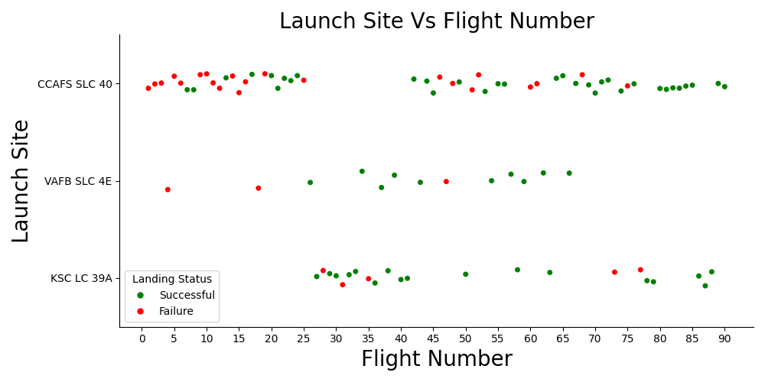
Flight Number vs. Launch Site
CCAFS LC-40 success rate of 60%
KSC LC-39A success rate of 77%
VAFB SLC 4ES success rate of 77%
Notes:
EDA with Visualization*
jupyter-labs-eda-dataviz.ipynb
Task 1: Visualize the relationship between Flight Number and Launch Site
Explanation: CCAFS LC-40, has a success rate of 60 %, while KSC LC-39A and VAFB SLC 4E has a success rate of 77%.
Launch Site Vs Flight Number (Jittered Strip Plot)

Slide 19
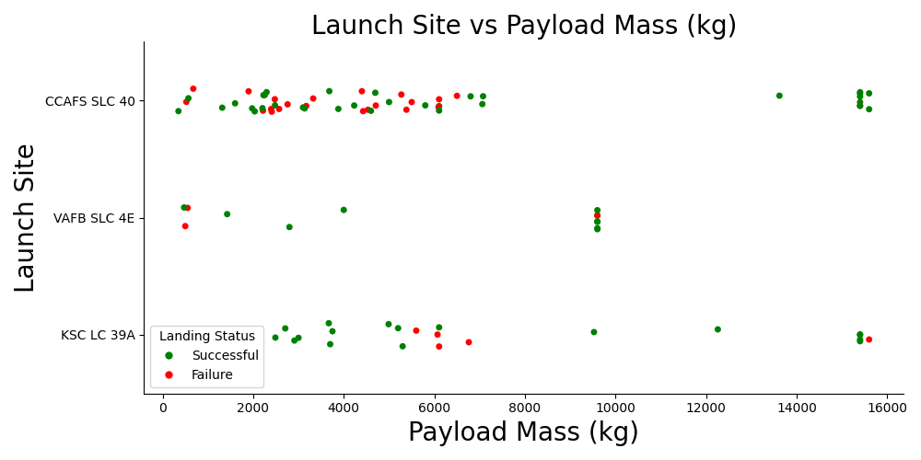
Payload vs. Launch Site
VAFB-SLC launchsite there are no rockets launched for heavypayload mass
Greater than 10000 kg
Notes:
EDA with Visualization*
jupyter-labs-eda-dataviz.ipynb
Task 2: Visualize the relationship between Payload and Launch Site
Explanation: For The VAFB-SLC launchsite there are no rockets launched for heavypayload mass(greater than 10000).

Slide 20
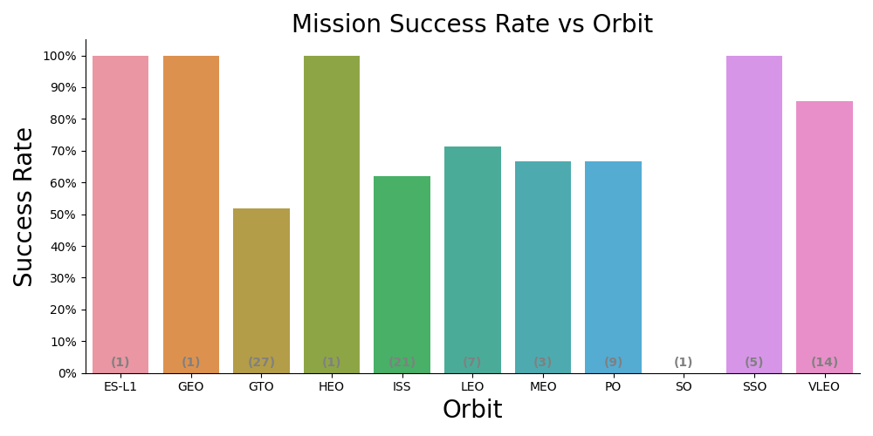
Success Rate vs. Orbit Type
ES-L1, GEO, HEO, and SSO orbits have high success rates.
Notes:
EDA with Visualization*
jupyter-labs-eda-dataviz.ipynb
Task 3: Visualize the relationship between success rate of each orbit type
Explanation: The plotted bar chart shows the ES-L1, GEO, HEO, and SSO orbits have high success rates.

Slide 21
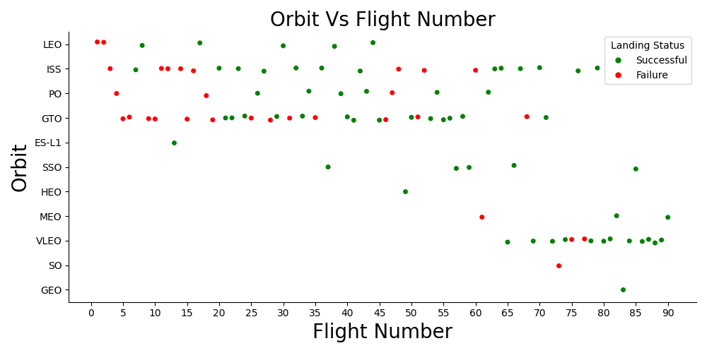
Flight Number vs. Orbit Type
In the LEO orbit the Success is related to the number of flights;
There is no relationship between flight number when in GTO orbit.
Notes:
EDA with Visualization*
jupyter-labs-eda-dataviz.ipynb
Task 4: Visualize the relationship between FlightNumber and Orbit type
Explanation: In the LEO orbit the Success is related to the number of flights; there is no relationship between flight number when in GTO orbit.

Slide 22
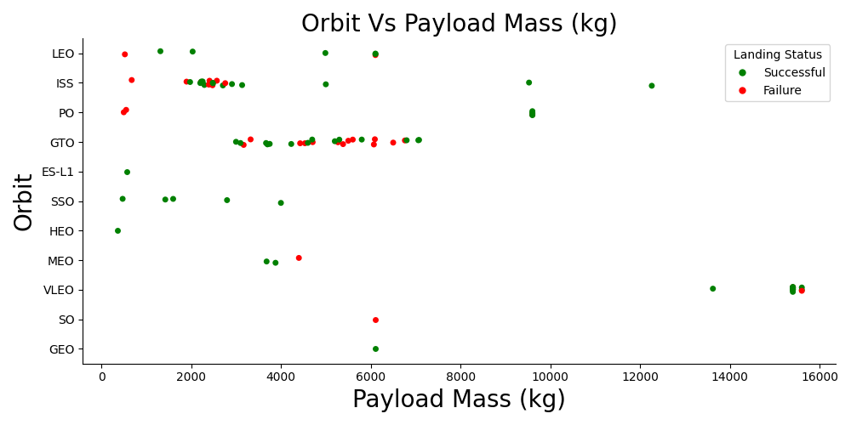
Payload vs. Orbit Type
With heavy payloads the successful landing are higher for Polar, LEO and ISS.
Notes:
EDA with Visualization*
jupyter-labs-eda-dataviz.ipynb
Task 5: Visualize the relationship between Payload and Orbit type
Explanation: With heavy payloads the successful landing are higher for Polar, LEO and ISS.

Slide 23
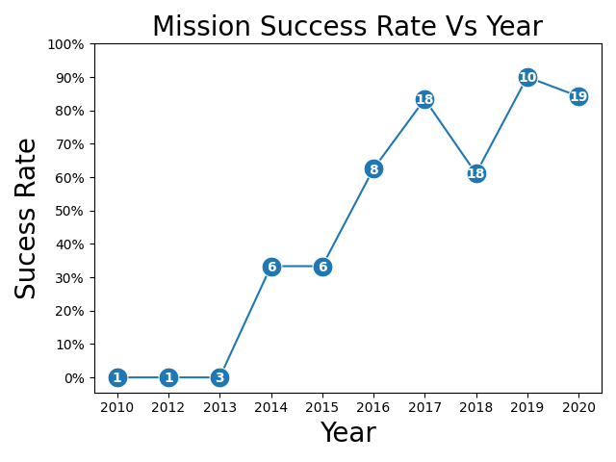
The yearly trend of success rate since 2013 kept increasing, until 2020
Notes:
EDA with Visualization*
jupyter-labs-eda-dataviz.ipynb
Task 6: Visualize the launch success yearly trend
Explanation: The success rate since 2013 kept increasing, until 2020

Slide 24
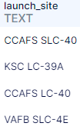
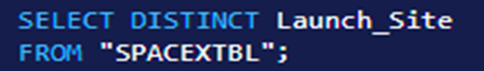
All Launch Site Names
Display the names of the unique launch sites in the space mission
Notes:
EDA with SQL*
jupyter-labs-eda-sql-edx.ipynb
Task 1: Display the names of the unique launch sites in the space mission
SELECT DISTINCT Launch_Site
FROM "SPACEXTBL“;

Slide 25
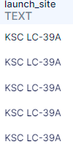
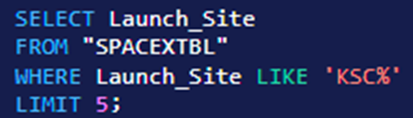
Launch Site Names Begin with 'KSC'
Display 5 records where launch sites begin with the string ‘KSC’
Notes:
EDA with SQL*
jupyter-labs-eda-sql-edx.ipynb
Task 2: Display 5 records where launch sites begin with the string 'KSC’
SELECT Launch_Site
From “SPACEXTBL”
Where Launch_Site LIKE ‘KSC%’ LIMIT 5;

Slide 26
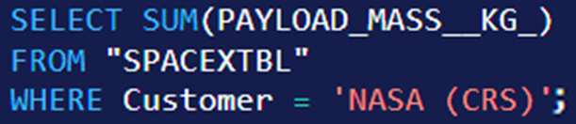
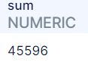
Total Payload Mass
Display the total payload mass carried by boosters launched by NASA (CRS)
Notes:
EDA with SQL*
jupyter-labs-eda-sql-edx.ipynb
Task 3: Display the total payload mass carried by boosters launched by NASA (CRS)
SELECT SUM(PAYLOAD_MASS__KG_)
FROM "SPACEXTBL"
WHERE Customer = 'NASA (CRS)’;

Slide 27
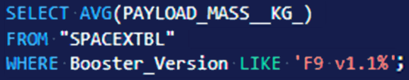
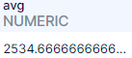
Average Payload Mass by F9 v1.1
Display average payload mass carried by booster version F9 v1.1
27
Notes:
EDA with SQL*
jupyter-labs-eda-sql-edx.ipynb
Task 4: Display average payload mass carried by booster version F9 v1.1
SELECT AVG(PAYLOAD_MASS__KG_)
FROM "SPACEXTBL"
WHERE Booster_Version = 'F9 v1.1%’;

Slide 28
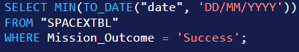
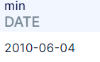
First Successful Ground Landing Date
List the date where the first successful landing outcome in a drone ship was achieved.
28
Notes:
EDA with SQL*
jupyter-labs-eda-sql-edx.ipynb
Task 5: List the date where the first successful landing outcome in a drone ship was achieved.
SELECT MIN(TO_DATE("date", 'DD/MM/YYYY'))
FROM "SPACEXTBL"
WHERE Mission_Outcome = 'Success';

Slide 29
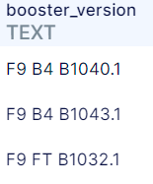
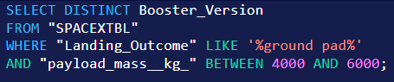
Successful Drone Ship Landing
Payload between 4000kg and 6000kg
List the names of the boosters which have success in ground pad
and have payload mass greater than 4000 but less than 6000
Notes:
EDA with SQL*
jupyter-labs-eda-sql-edx.ipynb
Task 6: List the names of the boosters which have success in ground pad and have payload mass greater than 4000 but less than 6000
SELECT DISTINCT Booster_Version
FROM "SPACEXTBL"
WHERE "Landing_Outcome" LIKE '%ground pad%'
AND "payload_mass__kg_" BETWEEN 4000 AND 6000;

Slide 30
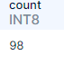
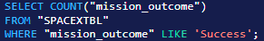
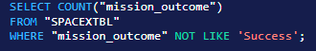
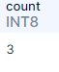
Total Number
Successful and Failure Mission Outcomes
List the total number of successful and failure mission outcomes
Notes:
EDA with SQL*
jupyter-labs-eda-sql-edx.ipynb
Task 7: List the total number of successful and failure mission outcomes
SELECT COUNT("mission_outcome")
FROM "SPACEXTBL"
WHERE "mission_outcome" LIKE 'Success';
SELECT COUNT("mission_outcome")
FROM "SPACEXTBL"
WHERE "mission_outcome" NOT LIKE 'Success';

Slide 31
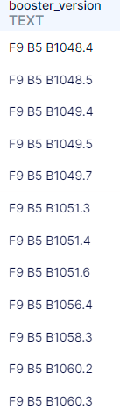
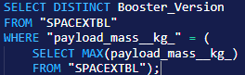
Boosters Carried Maximum Payload
List the names of the booster_versions
that have carried the maximum payload mass, using a subquery.
Notes:
EDA with SQL*
jupyter-labs-eda-sql-edx.ipynb
Task 8: List the names of the booster_versions which have carried the maximum payload mass. Use a subquery
SELECT DISTINCT Booster_Version
FROM "SPACEXTBL"
WHERE "payload_mass__kg_" = (
SELECT MAX(payload_mass__kg_)
FROM "SPACEXTBL");

Slide 32
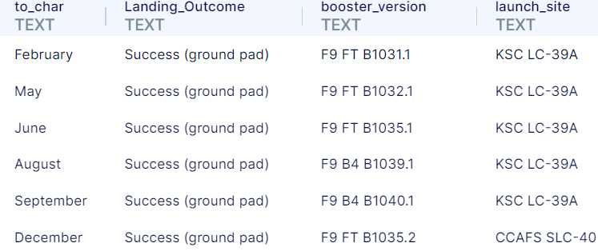
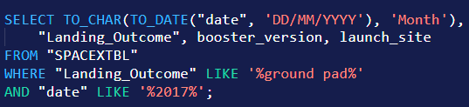
Launch Records
2015
List the records which will display
the month names, successful landing_outcomes in ground pad,
booster versions, launch_site for the months in year 2017
Notes:
EDA with SQL*
jupyter-labs-eda-sql-edx.ipynb
Task 9: List the records which will display the month names, successful landing_outcomes in ground pad ,booster versions, launch_site for the months in year 2017
SELECT TO_CHAR(TO_DATE("date", 'DD/MM/YYYY'), 'Month'), "Landing_Outcome", booster_version, launch_site
FROM "SPACEXTBL"
WHERE "Landing_Outcome" LIKE '%ground pad%'
AND "date" LIKE '%2017%';

Slide 33
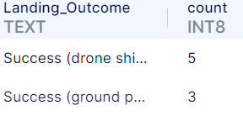

Rank Landing Outcomes
Rank the count of successful landing_outcomes between
the date 6/4/2010 and 3/20/2017 in descending order.
Notes:
EDA with SQL*
jupyter-labs-eda-sql-edx.ipynb
Task 10: Rank the count of successful landing_outcomes between the date 2010-06-04 and 2017-03-20 in descending order.
SELECT "Landing_Outcome", Count("Landing_Outcome")
FROM "SPACEXTBL"
WHERE "Landing_Outcome" LIKE '%Success%'
AND TO_DATE("date", 'DD/MM/YYYY') >= TO_DATE('04/06/2010', 'DD/MM/YYYY')
AND TO_DATE("date", 'DD/MM/YYYY') <= TO_DATE('20/03/2017', 'DD/MM/YYYY')
Group By "Landing_Outcome"
Order By Count("Landing_Outcome") DESC;

Slide 34
Section 3 Interactive Analytics
Notes:
Interactive Visual Analytics with Folium*
lab_jupyter_launch_site_location.ipynb
Task 1: Mark all launch sites on a map
Task 2: Mark the success/failed launches for each site on the map
Task 3: Calculate the distances between a launch site to its proximities

Slide 35

SpaceX’s Launch Sites
Folium Map
SpaceX’s Launch sites are in close proximity to Coast Lines, Highways,
and Railway Lines, while avoiding close proximity to Cities.
Notes:
Interactive Visual Analytics with Folium*
lab_jupyter_launch_site_location.ipynb
Task 1: Mark all launch sites on a map

Slide 36




Folium Map of Launch Sites VAFB SLC-4E Showing Successful Vs Failed Launches
The color-labeled markers are in marker clusters,
help identify launch success vs Failure rates.
Notes:
Interactive Visual Analytics with Folium*
lab_jupyter_launch_site_location.ipynb
Task 2: Mark the success/failed launches for each site on the map

Slide 37


Folium Map of Launch Sites VAFB SLC-4E Showing Distance to Closest Coast line, City, Highway, and Railway
Average distance coastline is 2.68
Average distance to a cities is 15.45 km
Average distance to highway is 4.05 km
Average distance to Railway is 1.16 km
Notes:
Interactive Visual Analytics with Folium*
lab_jupyter_launch_site_location.ipynb
Task 3: Calculate the distances between a launch site to its proximities

Slide 38
Section 4 Predictive Analysis
Notes:
Build an Interactive Dashboard with Ploty Dash*
spacex_dash_app.py
Task 1: Add a dropdown list to enable Launch Site selection
Task 2: Add a pie chart to show the total successful launches count for all sites
Task 3: Add a callback function for `site-dropdown` as input, `success-pie-chart` as output.
Task 4: Add a callback function for `site-dropdown` and `payload-slider` as inputs, `success-payload-scatter-chart` as output

Slide 39

Launch Success Count
All Cites, 57.1% Successful Launches, 42.9 % Failed Launches
Notes:
Build an Interactive Dashboard with Ploty Dash*
spacex_dash_app.py
Show the screenshot of launch success count for all sites, in a pie chart
Launch Success Count All Cites, 57.1% Successful Launches, 42.9 % Failed Launches

Slide 40

Highest Success Rate
KSC LC-39A
76.9% Successful Launches, 23.1% Failed Launches
Notes:
Build an Interactive Dashboard with Ploty Dash*
spacex_dash_app.py
Show the screenshot of the pie chart for the launch site with highest launch success ratio
Highest Success Rate KSC LC-39A, 76.9% Successful Launches, 23.1% Failed Launches

Slide 41

Payload and Launch Success
Correlation
Smaller payloads have a higher success rate than do larger weighted payloads.
Notes:
Build an Interactive Dashboard with Ploty Dash*
spacex_dash_app.py
Show screenshots of Payload vs. Launch Outcome scatter plot for all sites, with different payload selected in the range slider

Slide 42
Section 5
Predictive Analysis
Notes:
Machine Learning Prediction lab
predictive analysis
SpaceX_Machine Learning Prediction_Part_5.ipynb
Task 1: Create a NumPy array from the column "Class" in "data<", by applying the method to_numpy(), then assign it to the variable Y, make sure the output is a Pandas series (only one bracket df\['name of column']).
Task 2: Standardize the data in "X" then reassign it to the variable "X" using the transform provided below.
Task 3: Use the function train_test_split to split the data X and Y into training and test data. Set the parameter test_size to 0.2 and random_state to 2. The training data and test data should be assigned to the following labels. ("X_train, X_test, Y_train, Y_test")
Task 4: Create a logistic regression object then create a GridSearchCV object "logreg_cv" with cv = 10. Fit the object to find the best parameters from the dictionary "parameters".
Task 5: Calculate the accuracy on the test data using the method "score":
Task 6: Create a support vector machine object then create a "GridSearchCV" object "svm_cv" with cv - 10. Fit the object to find the best parameters from the dictionary "parameters".
Task 7: Calculate the accuracy on the test data using the method "score":
Task 8: Create a decision tree classifier object then create a "GridSearchCV" object "tree_cv" with cv = 10. Fit the object to find the best parameters from the dictionary "parameters".
Task 9: Calculate the accuracy of tree_cv on the test data using the method "score"
Task 10: Create a k nearest neighbors object then create a "GridSearchCV" object "knn_cv" with cv = 10. Fit the object to find the best parameters from the dictionary "parameters".
Task 11: Calculate the accuracy of tree_cv on the test data using the method "score":
Task 12: Find the method performs best

Slide 43


Classification Accuracy
Classification Models:
Logistic Regression
Support Vector Machine
Decision Tree
k-Nearest Neighbors
Notes:
Machine Learning Prediction lab
SpaceX_Machine Learning Prediction_Part_5.ipynb
Classification Models:
Logistic Regression
Support Vector Machine
Decision Tree
k-Nearest Neighbors
By a small margin, SVM had the highest classification accuracy.

Slide 44





Confusion Matrix
Support Vector Machine has a not statistically significant edge; all four models ultimately had the same accuracy score.
Notes:
Machine Learning Prediction lab
SpaceX_Machine Learning Prediction_Part_5.ipynb
Support Vector Machine has a not statistically significant edge.

Slide 45
Conclusions
The CCAFS LC-40 launch site has a success rate of 60 %, and the KSC LC-39A and VAFB SLC 4E sites have a success rate of 77%.
The ES-L1, GEO, HEO, and SSO orbits have the highest success rates.
For the LEO Orbit, success is directly related to the number of flights; however, there is no relationship between flight numbers for the GTO orbit.
With heavy payloads, the successful landing rate is higher for the Polar, LEO, and ISS Orbit types.
The success rate between 2013-2020 kept an upward trend.
Across all sites, there was a 57.1% rate of successful launches and a 42.9 % rate of failed launches.
The site with the highest success rate is the KSC LC-39A site; 76.9% of their launches were successful, with a 23.1% rate of failed launches.
Payload and launch success rates correlate in that the smaller payloads have a higher success rate than larger weighted payloads.
Tested Accuracy using the following four classification models: Logistic Regression, Support Vector Machine, Decision Tree, and k-nearest Neighbors.
Support Vector Machine has a not statistically significant edge, but all four models have extraordinarily similar outcomes. None of them are better than the others.
Notes:
The CCAFS LC-40 launch site has a success rate of 60 %, and the KSC LC-39A and VAFB SLC 4E sites have a success rate of 77%.
The ES-L1, GEO, HEO, and SSO orbits have the highest success rates.
For the LEO Orbit, success is directly related to the number of flights; however, there is no relationship between flight numbers for the GTO orbit.
With heavy payloads, the successful landing rate is higher for the Polar, LEO, and ISS Orbit types.
The success rate between 2013-2020 kept an upward trend.
Across all sites, there was a 57.1% rate of successful launches and a 42.9 % rate of failed launches.
The site with the highest success rate is the KSC LC-39A site; 76.9% of their launches were successful, with a 23.1% rate of failed launches.
Payload and launch success rates correlate in that the smaller payloads have a higher success rate than larger weighted payloads.
Tested Accuracy using the following four classification models: Logistic Regression, Support Vector Machine, Decision Tree, and k-nearest Neighbors.
Support Vector Machine has a not statistically significant edge, but all four models have extraordinarily similar outcomes. None of them are better than the others.

Slide 46
Thank you

